Slide 1
Destiny 2
Exotic Armor
BY: SEAN LI AND PETER MENDOZA

Slide 2
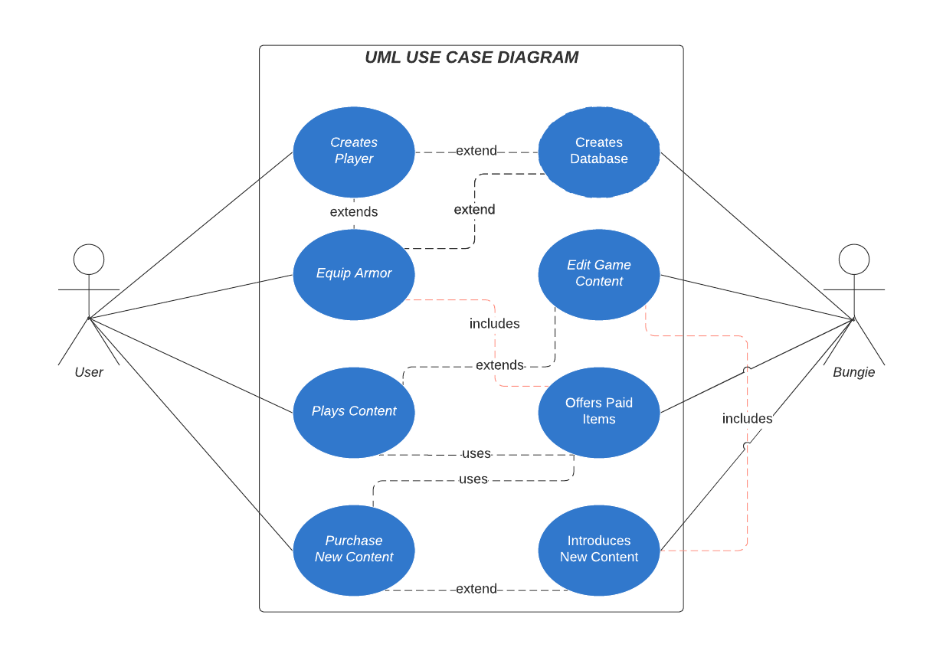
UML Diagram
Lucid Chart

Slide 3
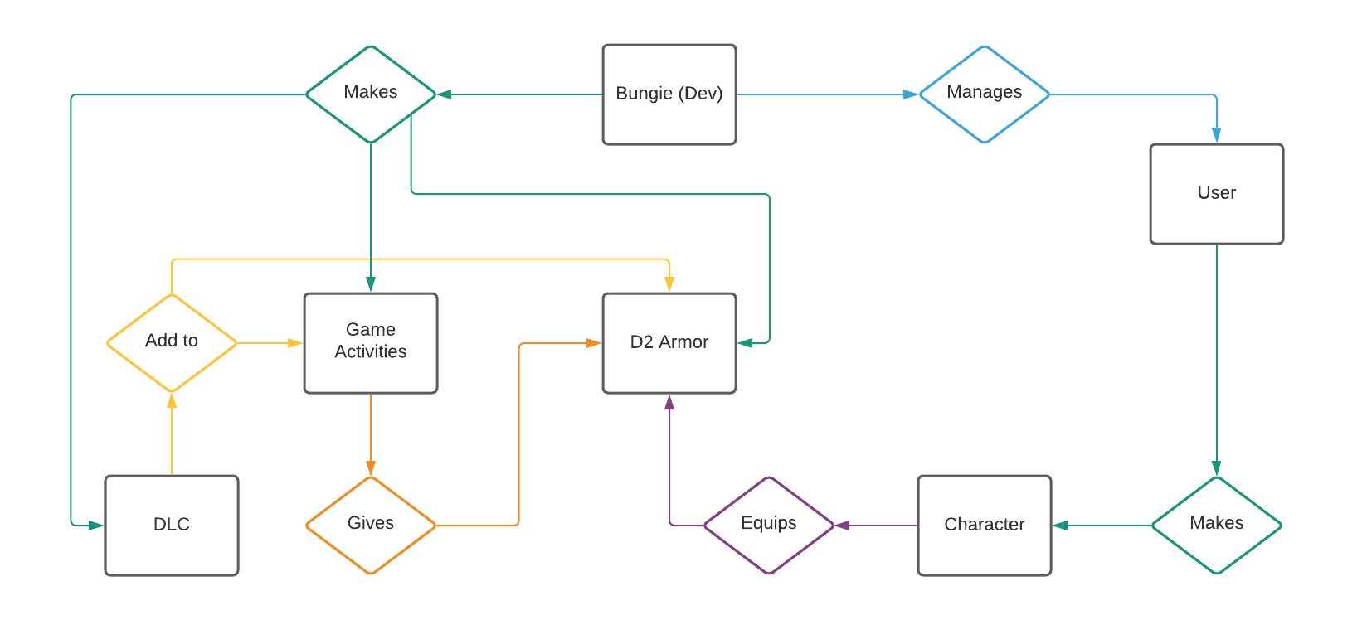
E/R Diagram

Slide 4
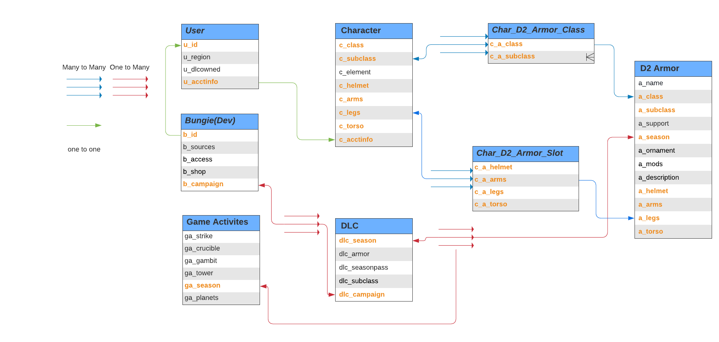
Relational Schema

Slide 5
Github Repo:
Sean02/Destiny_2_Exotic_Armor: Database Project for CSE111 - Database Systems (github.com)

Slide 6

That’s all Guardian
Notes:
https://github.com/Sean02/Destiny_2_Exotic_Armor

